Slide 1
Credibly Project Plan
September , 2023
Confidential

Slide 2

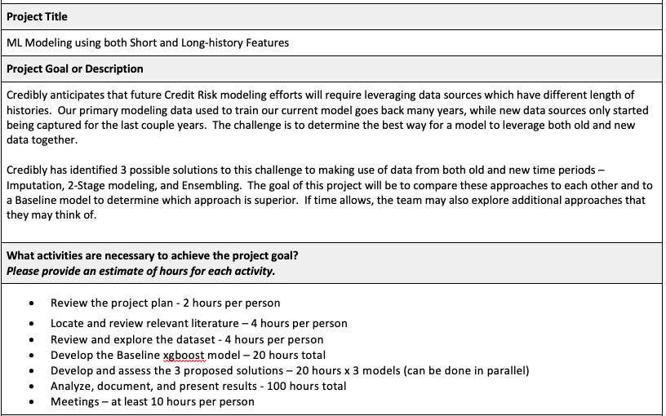
Project Goal

Slide 3
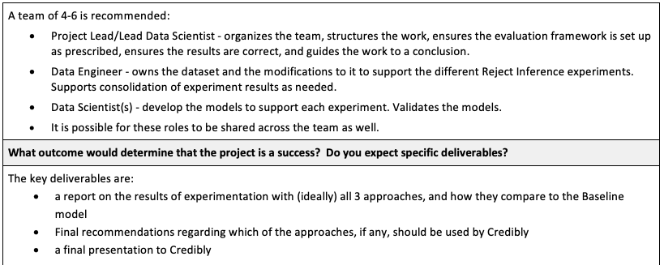
Roles & Deliverables

Slide 4
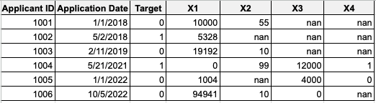
The Challenge with our Data
Modeling data is a mix of “Long History” and “Short History” features.
Long History Features
Short History Features
Old
(has only Long history features)
New
(has Long and Short history features)
Long History Features (X1,X2) have most values populated over the entire time period (2018-2022, in this example). These are called Long_N in the dataset.
Short History Features (X3,X4) have many values populated during a newer time period (2021-2022, in this example), and no values populated during an older time period (2018-2019, in this example). These are called Short_N in the dataset.

Slide 5
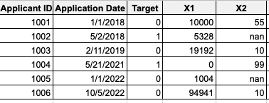
Baseline Model
The baseline model should be built using xgBoost from the Long-history features on the Old+New data.
Long History Features
Baseline Model Development Dataset
Be sure to leverage the Train vs. Validation flag on the dataset called TrainVal. Models should be trained using only the Train_60 samples, and performance assessed using only the Val_40 samples.

Slide 6
Modeling
Three methods to model data with a mix of Long and Short History Features:
Imputation
2-Stage Modeling
Ensembling
These can be compared to a Baseline model built from the New time period only, using both Long and Short History features.

Slide 7
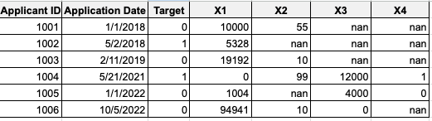
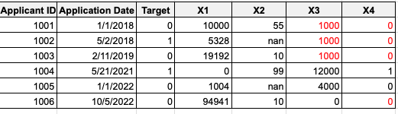
1) Imputation
Impute the nan Short History values using some Imputation strategy
(e.g., Median/Mode), then model.
Short History Features
Model Development Dataset

Slide 8
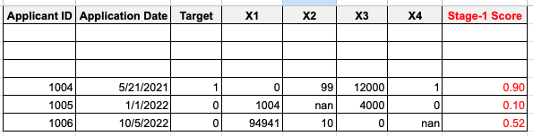
*Be mindful of Train vs. Validation in the setup!
2) 2-Stage Modeling
Build a Stage-1 Model on the Old+New time periods. This could be just the Baseline model.
Long History Features
Stage-1
Development
Dataset
Append Stage-1 model score back to the data, and Build a Stage-2 model on the New data with features = Stage-1 score, Long, and Short History Features as the final model.
Long History
Features
Short History
Features
Stage-2 Model Development Dataset

Slide 9
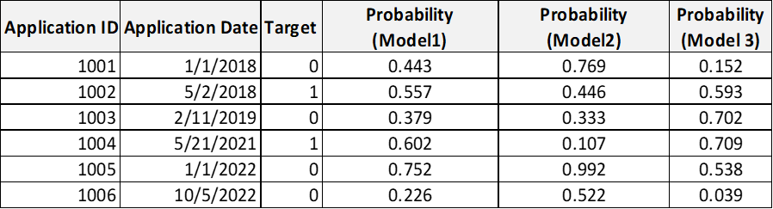
*Be mindful of Train vs. Validation in the setup!
3) Ensembling (Example)
Build multiple models on different combinations of feature lists and Old + New data
Model 3
Model 1
Model 2
Tip: Fewer models = lower complexity, which is always preferred since it improves transparency and lowers Operational Risk.
Aggregate predictions from candidate models to generate final model output
Use model output to build stacking model (mean, xgboost, etc)
Final prediction

Slide 10
Results
Identifying the Champion method should involve looking at model performance as well as other aspects of the model as well, like the input features*.
Model Qualities:
Performance, as measured by AUC or Modified Gini
Features, as measured by:
Number of Features
Feature Ranking 1: Percentage that are Long History Features in the top 5 feature ranking.
Feature Ranking 2: Percentage of Short History Features selected in the model.
*Reference: https://medium.com/@T_Jen/feature-importance-for-any-model-using-permutation-7997b7287aa

Slide 11
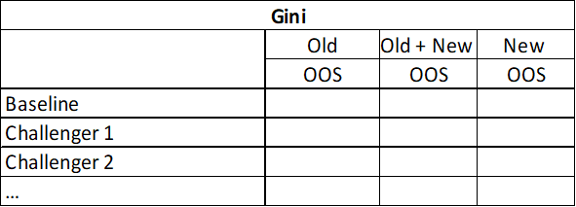
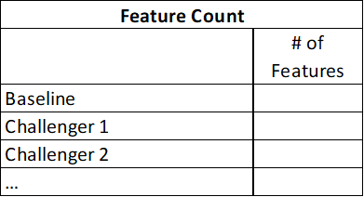

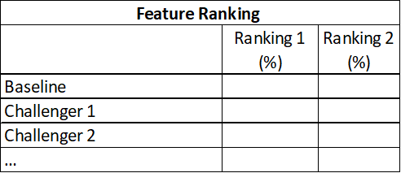
Results (Template)

Slide 12
For Discussion
Roles - Team should self-organize
Who will be Point of Contact?
Meet once per week?
5pm (or 5:15pm ET)
Team to choose a day of the week
To make communications more efficient, please consolidate questions as much as possible, and have them sent by your Point of Contact
We will share the data after this meeting
It is required that all copies of the data be deleted at the end of the project, and that a confirmation be sent back to us thereafter.

